Slide 1




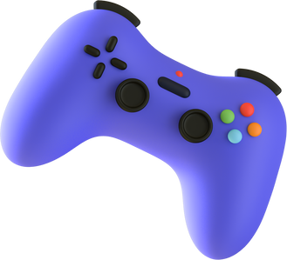

BASIC GAME DEVELOPMENT WORKSHOP
BUILBOX
GAMING
SPEAKER : MERWIN PINTO
TY BTECH AI & DS

Slide 2

TOPICS FOR TODAY
Intoduction to Gaming Software.
Two Types of Gaming Softwares coded and non coded.
Difference between coded and non coded games.
Advantages of Gaming in Industry.
Intro to Hands on experience with Gaming.

Slide 3

A SHORT INTRO
Journey into the World of Interactive Adventures
Gaming offers a unique experience where players become active participants in virtual worlds, assuming roles of heroes, villains, and everything in between.
Gaming Makes Objects to move in places where we cannot see in reality just like Car Flying in the Sky which has No Wings to fly ! or even Time Elapsing and Speed Movement !

Slide 4

BEST GAMING SOFTWARES
CODED
NON CODED
UNITY
BUILDBOX

Slide 5

DIFFERENCE BETWEEN
CODED AND NON CODED GAMES
CODING GAMES
NON CODING GAMES
Coding Knowledge is needed.
No Coding Knowledge needed.
Slow due to code.
Faster due to Drag and Drop.
Ultimate flexibility.
Limited flexibility compared to coding.
Better for complex games.
Better for Simple games.
2D and 3D both are possible.
2D and 3D both are possible.

Slide 6

WHAT IS BUILD BOX ?
Buildbox is a game development software that falls under the category of drag-and-drop game development tools.
Visual Interface
allows developers us to create game levels and mechanics by dragging and dropping pre-built components.
Asset Library
library of pre-made assets, objects, characters, and templates.
Advantage of this software
you can work on all these systems such as iOS, Android, Windows, macOS, etc.

Slide 7

THANK
YOU
Lets Proceed to
Practical Session now !

